Slide 1
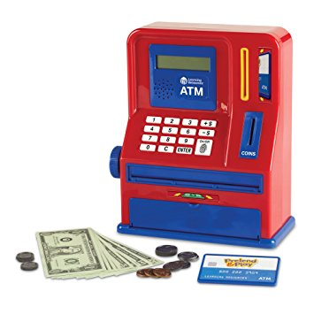
ATM Project
Mary Husain | Michal Porubcin | Andrew Quijano | Bryce Yoo

Slide 2
Overview
Core Functionality
User Interface
Encryption
Database
Online ATM
User Accounts
Tools & Services
Paragraph (if not needed, delete)
Bullet
Dash
Subbullet
Paragraph (if not needed, delete)
Bullet
Dash
Subbullet
Paragraph (if not needed, delete)
Bullet
Dash
Subbullet

Slide 3
Overview
Core Functionality
User Interface
Database
Encryption
Subhead | Subhead | Subhead | Subhead
Heading Bullet Dash Subbullet | Heading Bullet Dash Subbullet | Cloud-based Bullet Dash Subbullet | Explore Alternatives Bullet Dash Subbullet
Heading Bullet Dash Subbullet | Heading Bullet Dash Subbullet | Security Bullet Dash Subbullet | Hash Function Bullet Dash Subbullet
Heading Bullet Dash Subbullet | Heading Bullet Dash Subbullet | Heading Bullet Dash Subbullet | Heading Bullet Dash Subbullet

Slide 4
Core Functionality
User Accounts
First Name
Last Name
PIN Code
Account Balance
Services
Withdrawals
Multiples of $20
Quick withdrawal options from $20 - $100
Manual for amounts larger than $100
Deposits
Any positive amount (minimum $0.01)

Slide 5
Core Functionality
Code Documentation

Slide 6
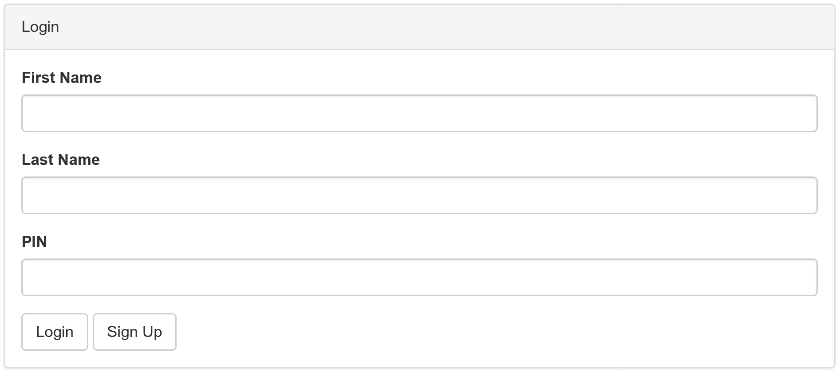
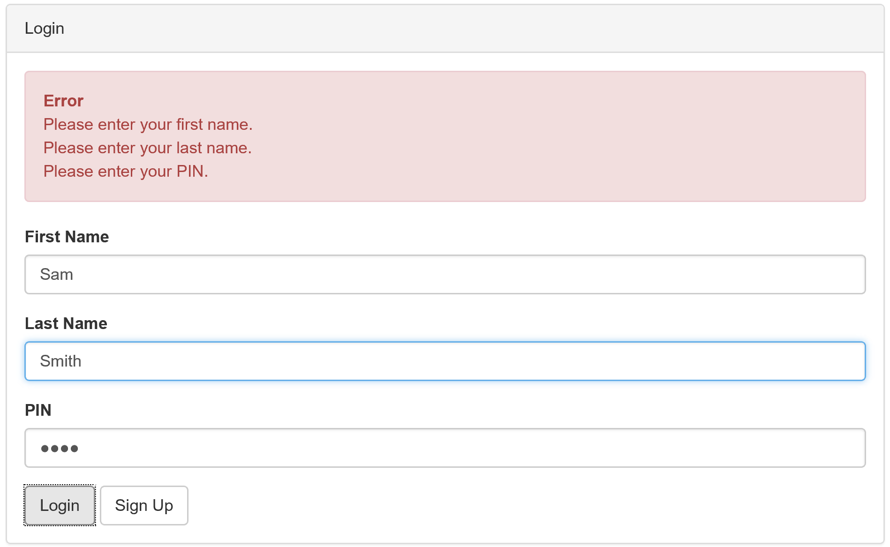
Login Screen and Validation

Slide 7
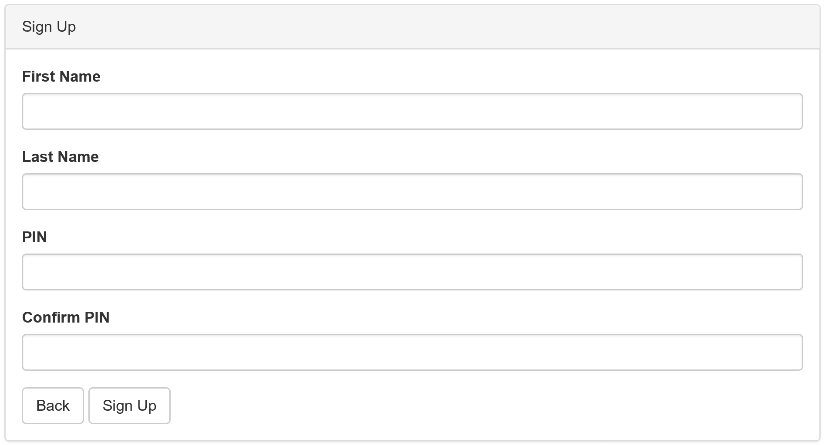
Sign Up Screen

Slide 8
Main Interface
Insert Picture

Slide 9
View Balance
Insert Picture

Slide 10
User Interface

Slide 11
Database
Heroku
Cloud Application Platform based on a managed container system
Platform as a service (PaaS)
Integrated data services and powerful ecosystem
App-centric approach for software delivery
Allows us to build, run and operate our app entirely in the cloud

Slide 12
Exploring Encryption Alternatives
Systematic-Key Encryption (e.g. AES)
Hash Function (e.g. RSA, blowfish)
Paragraph (if not needed, delete)
Reversible
Security: weak and highly vulnerable in the case of a hacked Database
Paragraph (if not needed, delete)
Irreversible
Security: robust and resistant brute force attacks
Blowflish is slower than RSA (this is good)
Add salt to protect against Rainow Tables (pre-computed hashes)
Implementation: simple with Bcrypt
Easy blowflish package for C#
Obtained with Nuget

Slide 13
Hash Function Encryption
Deterministic
Pre-image
resistance
Adaptive
function
Secure Online
Teller Machine
Fast block
cipher
Collision
resistance
Small memory
footprint
Password
hashing
function
OpenBSD
Resistant to
rainbow
table attacks

Slide 14
Encryption and Security
Client
User enters PIN
Client hashes the PIN using Blowfish algorithm (with salt)
Client sends [Hashed PIN + salt] to server
Server
Signup: Server stores [Hashed PIN + salt] in database
Login: Server verifies Hashed PIN against value in database

Slide 15
Further Potential

